Slide 1
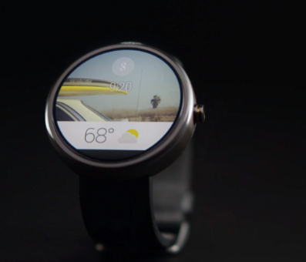
Gwatch

Slide 2
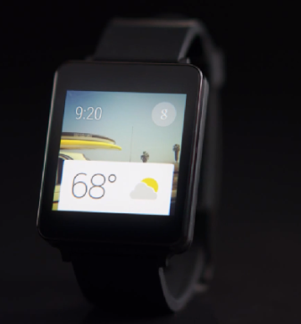
GWatch2

Slide 3
Manufactures
Google Nexus from LG will have 2 1.65 inch display, 240ppi, not yet choose processor
Gear2 from Samsung will have 1.63 inch display with 277 ppi, has a 1GHz, dual-core chip
Google’s Android smartwatch will also reportedly feature 512MB of RAM and 4GB of ROM storage, much like the Gear 2.

Slide 4
Release
1st Released of Android Wearable SDK on March 23
Manufactures:
Fossil, LG.
Later this year:
HTC, Samsung, Motorola
Chip manufactures: Intel, Qualcom

Slide 5
What does Android wearable have?
Features:
-voice commands:
set alarm, ask question, play music
- Detect name of song artist when user dance
-provide user updates on
weather, sports scores, travel times, etc…
-display health information: calories burned during the day
-Scanning boarding pass for airline flight like some Google phone....

Slide 6
UI
Entirely new UI
Based on voice and contextual information
Response with spoken answer
Or textual information

Slide 7
Backward compatibility?
-Set of apps already running on smartphones or tablets can run on Gwatch without modification
-Wearable app can run on smartphone and tablet with richer experience

Slide 8
Future features
Work with internet connected devices such as Garage door, automotives.

Slide 9
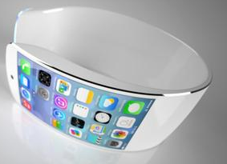
Discussion
Q: Do you think the Gwatch will replace smartphones in the future ?
Q: What do you think about this watch?

